Slide 1
Science to Policy S2P@UCR
Translating Science Workshop
Matt Barth
Nicole Cleary
Susan Hackwood
Doug Brown
CE-CERT
July 26, 2018

Slide 2
Students in the S2P program will gain insights into:
Policy making processes at the local, state and federal level
Where input of a scientist is important and valued
How a scientist can become part of the policy making process
Communication and other skills necessary for scientists to work effectively
with policy makers
Opportunities for professional development at UCR and elsewhere
The program curriculum will be developed by drawing insights from:
Experienced scientists who have had major impacts in public policy
Policy makers who value scientific input
Scientists who have had local, state or federal experience

Slide 3
2018-19 Academic Year:
Opportunities:
Science Policy Certificate
Science Translators Policy Course
Designated Emphasis (D.E.) in Public Policy
State Capitol visit to Sacramento
DC Vist to AAAS and NY National Science Policy Network
Webinars with guest lecturers
Public speaking workshops
Partnerships:
Bourns College of Engineering
School of Public Policy
School of Medicine
College of Natural and Agricultural Sciences
Department of Theatre, Film and Digital Production
Office of Government Affairs
University Communications

Slide 4
Science & Technology Policy Fellowships
AAAS Science & Technology Policy Fellowships One-year fellowships in Washington, D.C. in legislative, executive, and judicial branches
AAAS Congressional Science & Engineering Fellowships One-year fellowships in Washington, D.C. jointly administered via some scientific societies
NASEM Mirzayan Science & Technology Policy Graduate Fellowships Twelve-week policy fellowships at the National Academies
Presidential Management Fellowships, U.S. Office of Personnel Management Two-year fellowships in U.S. executive branch departments and agencies
John A. Knauss Marine Policy Fellowship Program, NOAA Sea Grant Program One-year fellowships in Washington, D.C. with focus on ocean, coastal, and Great Lakes
CCST California Science & Technology Policy Fellows Program One-year fellowships in Sacramento, CA with state legislature and executive agencies

Slide 5
Translating Science Workshop Session Plan
Science Policy 101
What are the avenues of science policy?
How does science communication influence policy?
Do you know where your funding comes from?
Elevator pitches: Summarize your dissertation in three sentences or less!
Communicating Effectively in Science Policy
Dos, don'ts, and key principles of science communication
Revise elevator pitches to be more powerful for policymakers
Simplify your pitch even further with a catchy ”book mark"
Lunch and presentation of bumper stickers and elevator pitches

Slide 6
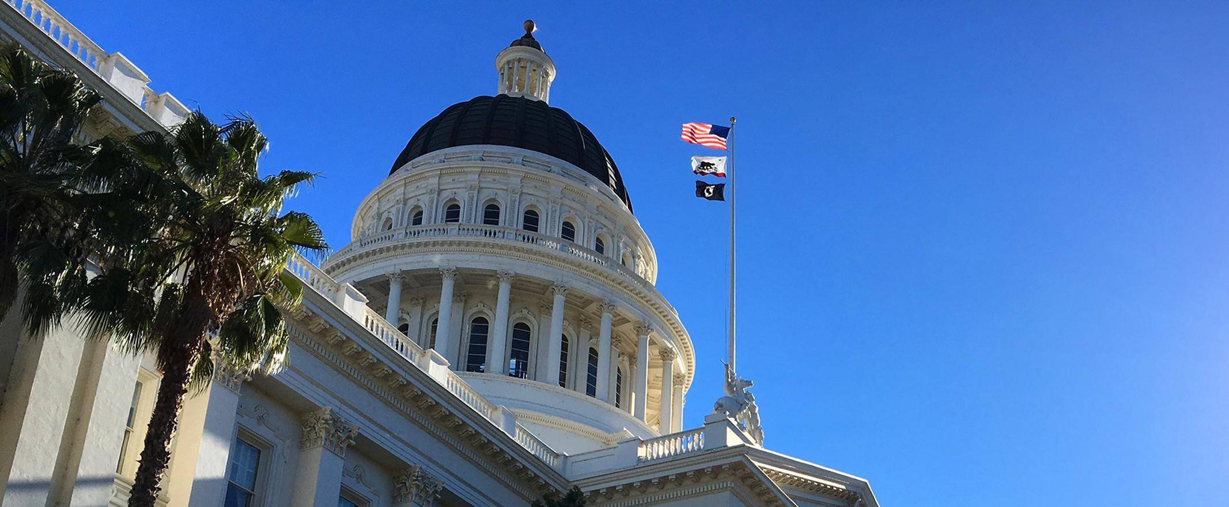
The Policy Making Process in California
Materials for this portion originally compiled by Sarah Brady, PhD, and Ben Young Landis

Slide 7
The Role of the State Legislature
Legislators (referred to as “Members” and ”Senators”) write and enact laws, which begin as bills.
A bill must pass through both houses of the Legislature, via committees.
Bills that pass both houses must go to the Governor for signature.

Slide 8
The Two Houses: The State Assembly
The State Assembly comprises of 80 districts, each represented by an Assemblymember.
The head of the Assembly has the title of Speaker.
The Speaker assigns Assemblymembers to various committees, which analyze and vote on bills on a specific topic (e.g., Assembly Energy and Utilities Committee)

Slide 9
The Two Houses: The State Senate
The State Senate comprises of 40 districts, each represented by a State Senator.
The head of the Senate has the title of President pro Tempore (the “pro Tem”).
The pro Tem assigns Senators to various committees, which analyze and vote on bills on a specific topic (e.g., Senate Health Committee)

Slide 10
A Bill Originating in the Assembly
Assembly
Committees
Assembly
Floor
BILL
Governor
vetoes, or
signs into LAW
Senate
Committees
Senate
Floor

Slide 11
Same Process Is Happening Concurrently for Senate Bills!
Assembly
Committees
(Policy, Fiscal)
Assembly
Floor
Assembly
Committees
Assembly
Floor
BILL
Governor
vetoes, or
signs into LAW
BILL
Governor
vetoes, or
signs into LAW
Senate
Committees
Senate
Floor
Senate
Committees
(Policy, Fiscal)
Senate
Floor

Slide 12
Committees and Calendars Are Key
A bill in committee is under great scrutiny.
Committee staff write bill analyses to point out implications and recommend amendments — often calling on expert input.
Committee hearings allow Members to consider expert testimonies and see the list of supporters.
Constitutional deadlines drive the process for committee hearings and bill passage out of each house

Slide 13
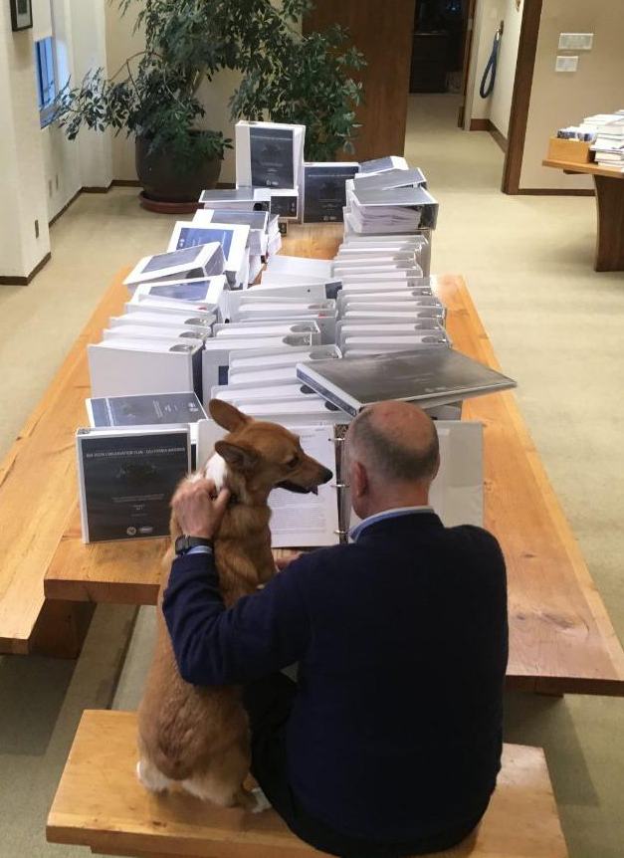
Governor Has Final Say
Even if both houses have passed the bill, the Governor can still veto it.
AB 1091 (mylar balloon release criminal fine)
Threat of veto if “Gas Tax” repealed in 2018
@annebgust

Slide 14
Politics and Intangibles
Bills are not carried/passed for different reasons.
Legislators are limited on the number of bills they are allowed to carry during each Legislative Session.
Legislators may ignore certain issues due to personal priorities, or must respond to the influence of party leader (e.g. Single Payer).
Science isn’t always the deciding factor.
“Optics” are important.

Slide 15
A Word on Staffers and Consultants
Legislative Staff and Aides are the eyes and ears for their Member. They distill everything they learn on every issue to inform their Member.
Committee Consultants perform bill analyses for their committees, and assess the merits of a bill.
They are the front line for your input on an issue or a bill.

Slide 16
The Executive Branch
Materials for this portion originally compiled by Christine Hochmuth Casey, PhD

Slide 17
What Does the Executive Branch Do?
Performs specific activities and/or creates regulations as directed by the Legislature.
Offices within the Executive Branch enforce laws within their jurisdiction.
Develops and proposes the Budget.
Responsible for the day-to-day operation of public services for Californians.

Slide 18
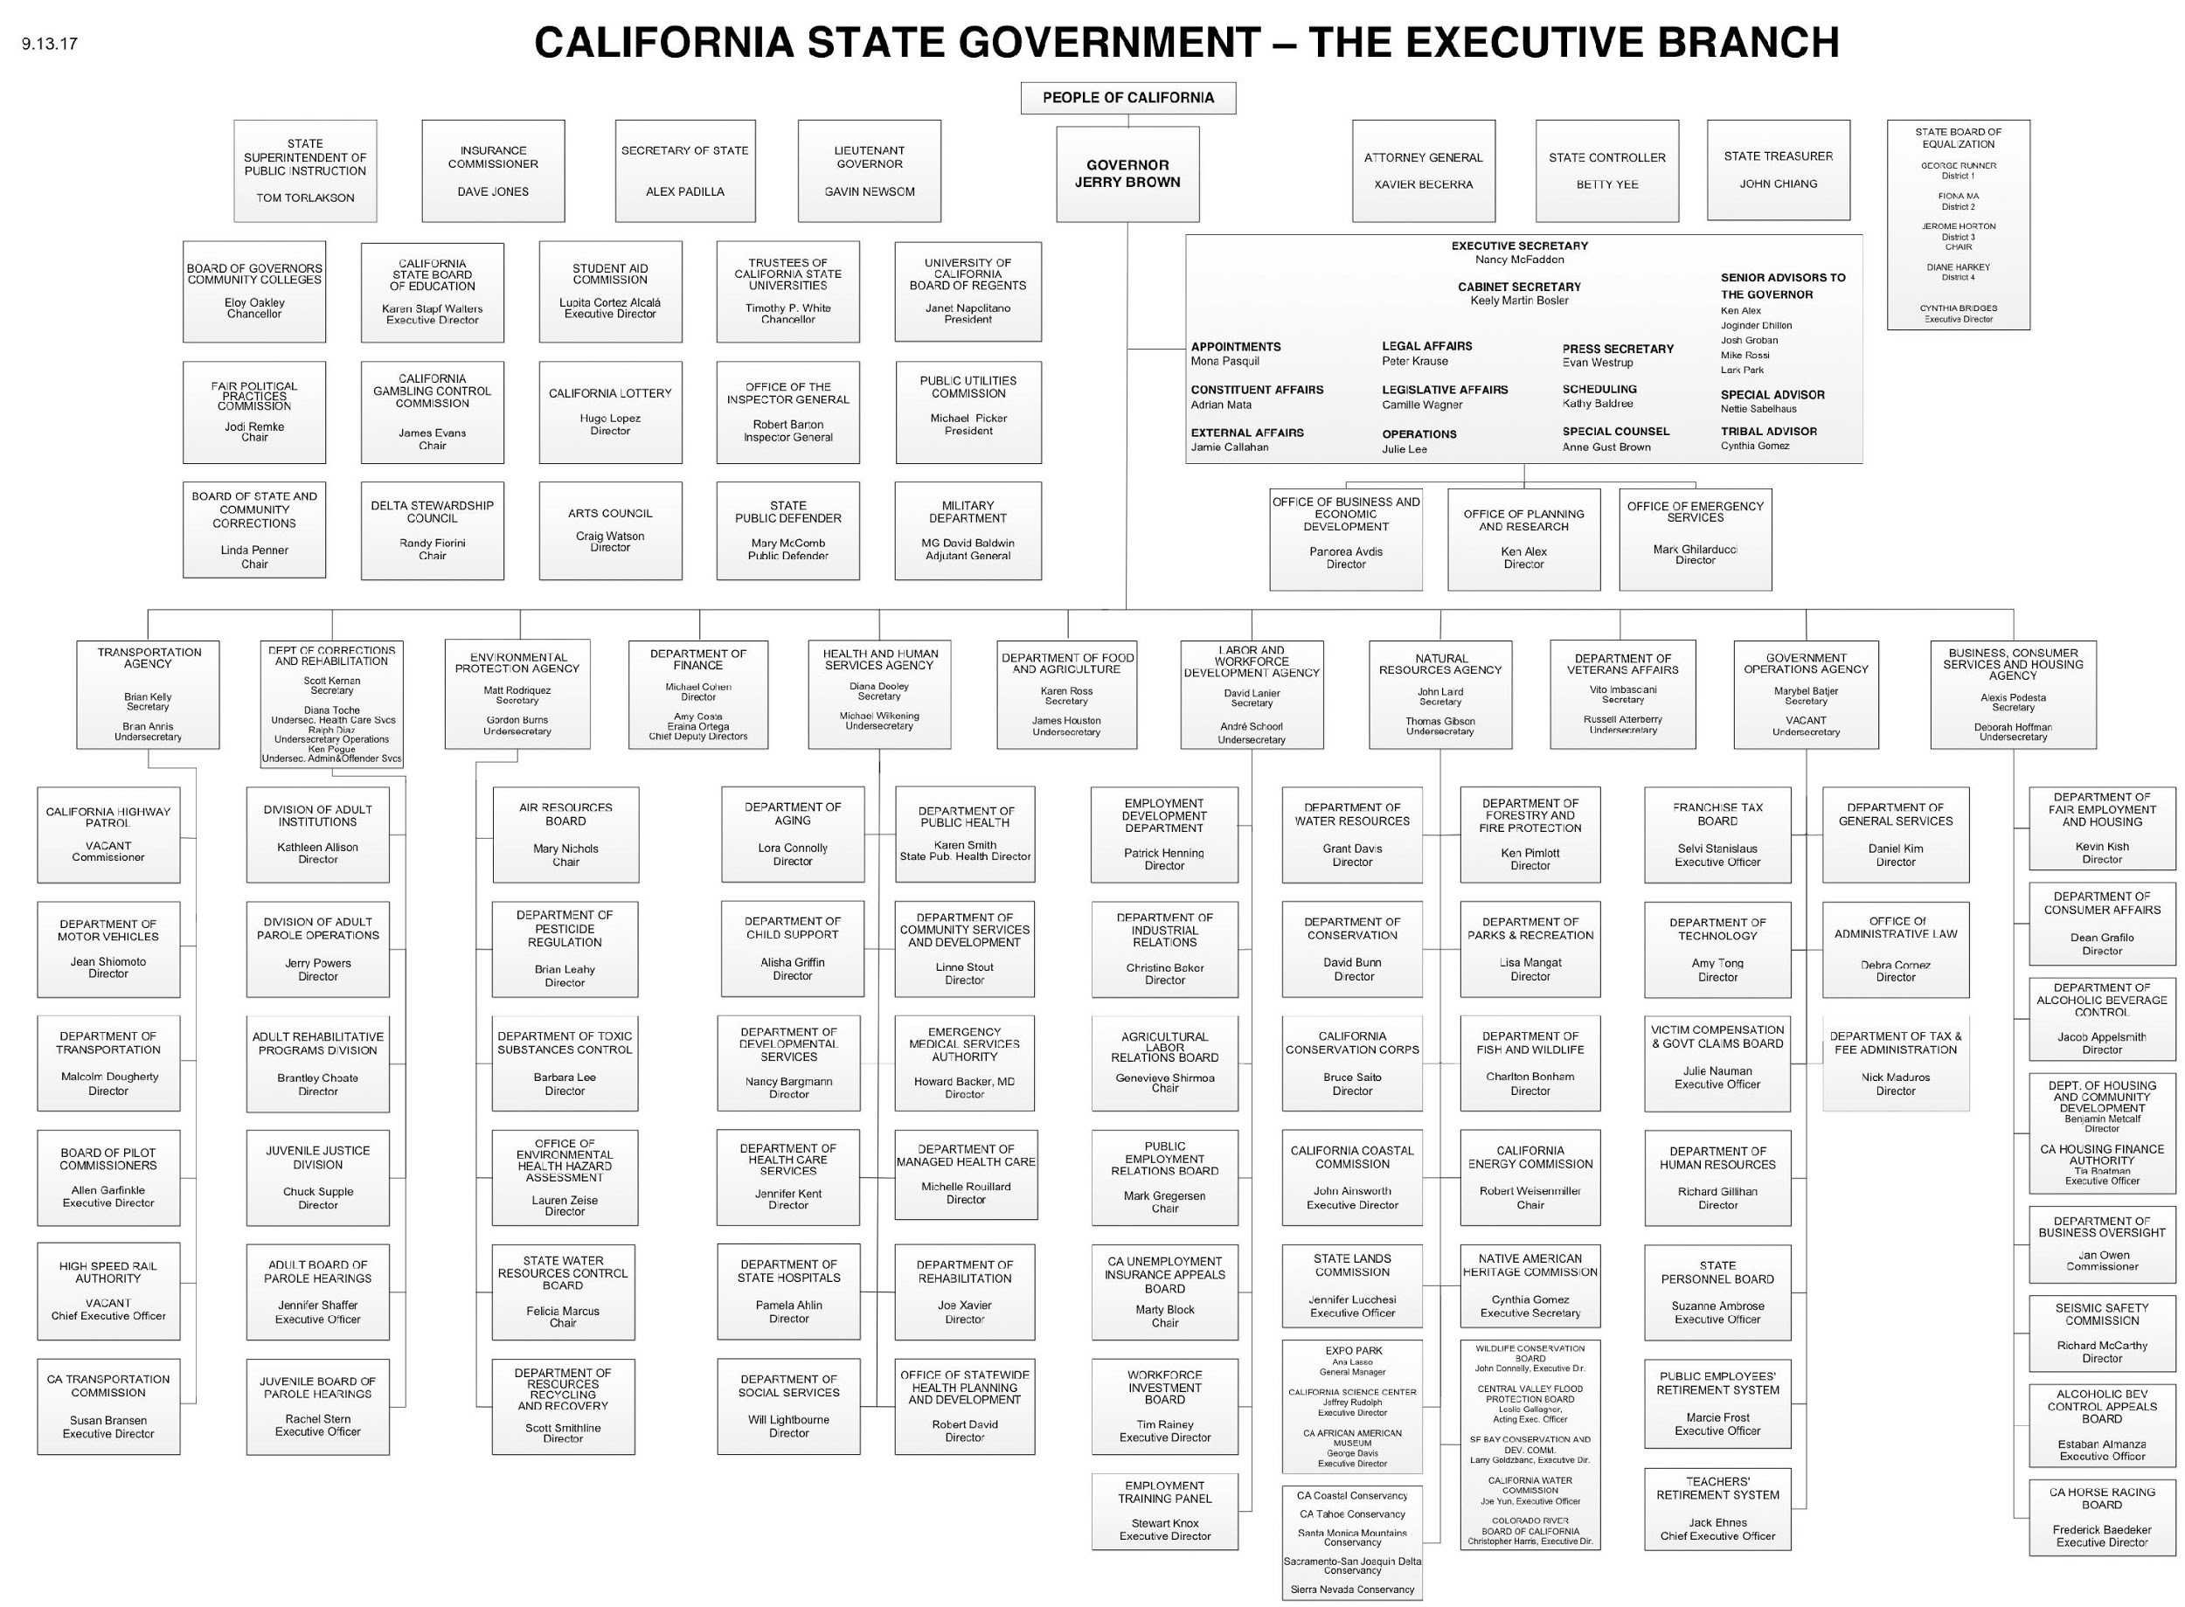
Notes:
because as you can see it is not a simple system…
I’m not going to leave this up for the next ten minutes until your eyes hurt, but I wanted to impress upon you the magnitude of this arm of government.
Even though it’s complex, as scientists and engineers we’re used to dealing with complex systems.

Slide 19
Departments, Boards, Commissions
Perform specific activities and/or create regulations as directed by the Legislature
AB 1496 (Thurmond, 2015) required the California Air Resources Board (CARB) to monitor methane emissions.
AB 243 (Wood, 2015) required several agencies (CDFA, DPR, CDPH, CDFW, SWRCB) to promulgate regulations or standards related to medical cannabis cultivation.

Slide 20
Departments, Boards, Commissions
Enforce laws within their jurisdiction
CARB enforces vehicle emissions standards.
Provides oversight for industries, professions, public resources
Coastal Commission reviews permits for activities such as coastal development, and enforces the California Coastal Act.

Slide 21
What Is the Difference Between Advocacy and Advice?
The difference can literally come down to the extra words: “I ask for your support of _________.”
Effective advocates do their best to sound like advisors in order to earn trust.
Effective advisors do their best to avoid sounding like advocates, in order to maintain trust.

Slide 22
Federal 101: 3 Branches
Executive Branch
President
The President’s Cabinet includes the Vice President and the heads of the 15 executive departments/agencies.
Legislative Branch
2 Chambers: U.S. House of Representatives (435 members) & Senate (100 Senators)
House Leadership: Speaker of the House, Minority Leader
Senate Leadership: Majority Leader, Minority Leader
Judicial Branch
U.S. Supreme Court, 13 district courts of appeals
Notes:
Speaker of the House: Rep. Paul Ryan (R)
Minority Leader: Rep. Nancy Pelosi (D)
Majority Leader: Sen. Mitch McConnell (R)
Minority Leader: Sen. Chuck Schumer (D)

Slide 23
R&D Budgets
State and Federal

Slide 25
Written by Julianne McCall and Paul Jacobs with contributions from Teresa Feo. The California Senate Offce of Research is a nonpartisan offce charged with serving the research needs of the California State Senate and assisting Senate members and committees with the development of effective public policy. The offce was established by the Senate Rules Committee in 1969. For more information, please visit http://sor.senate. ca.gov or call (916) 651-1500.

Slide 26
Federal Investment in UC Science Research
As the country’s largest academic research system, federal support for science research is key to the UC and UCR!
Federal funds account for more than half of total research funding for the UC with an immediate effect on our ability to support graduate students and post-doctoral scholars.
In Fiscal Year 2017 (October 1, 2016—September 30, 2017), nearly $2.9 billion of UC research funding came from the federal government.
UCR received over $100 million in federal research funding in FY 2017.
Notes:
Source: University of California, Talking Points: Federal Investment in Education, Research and Health Care

Slide 27
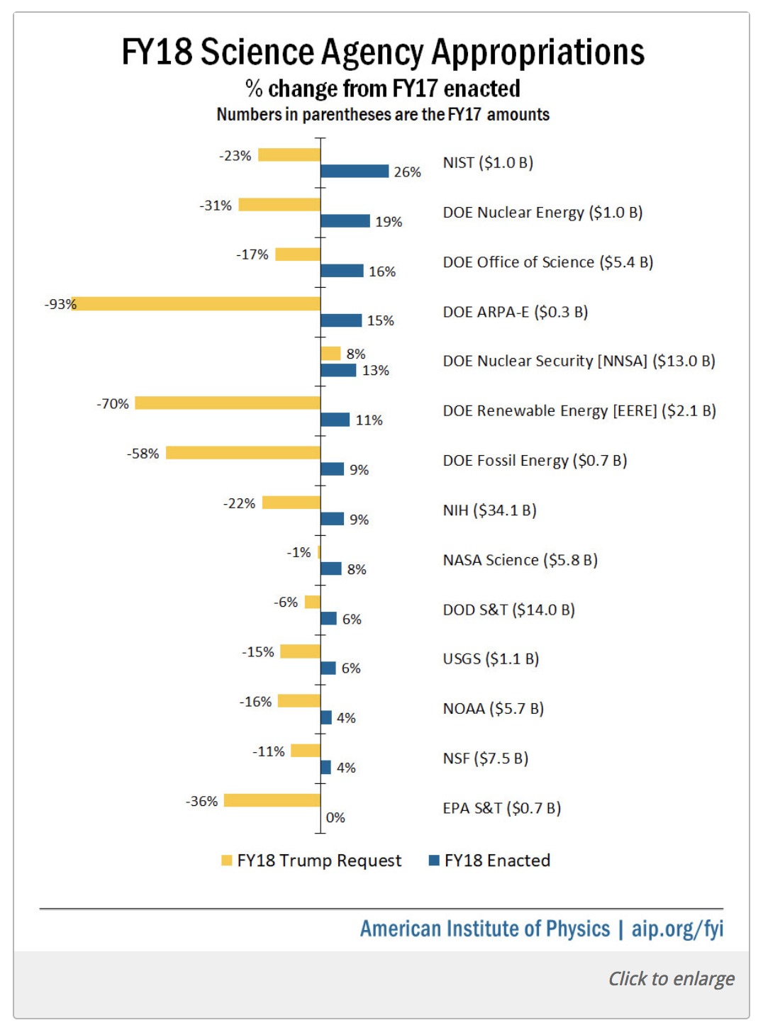
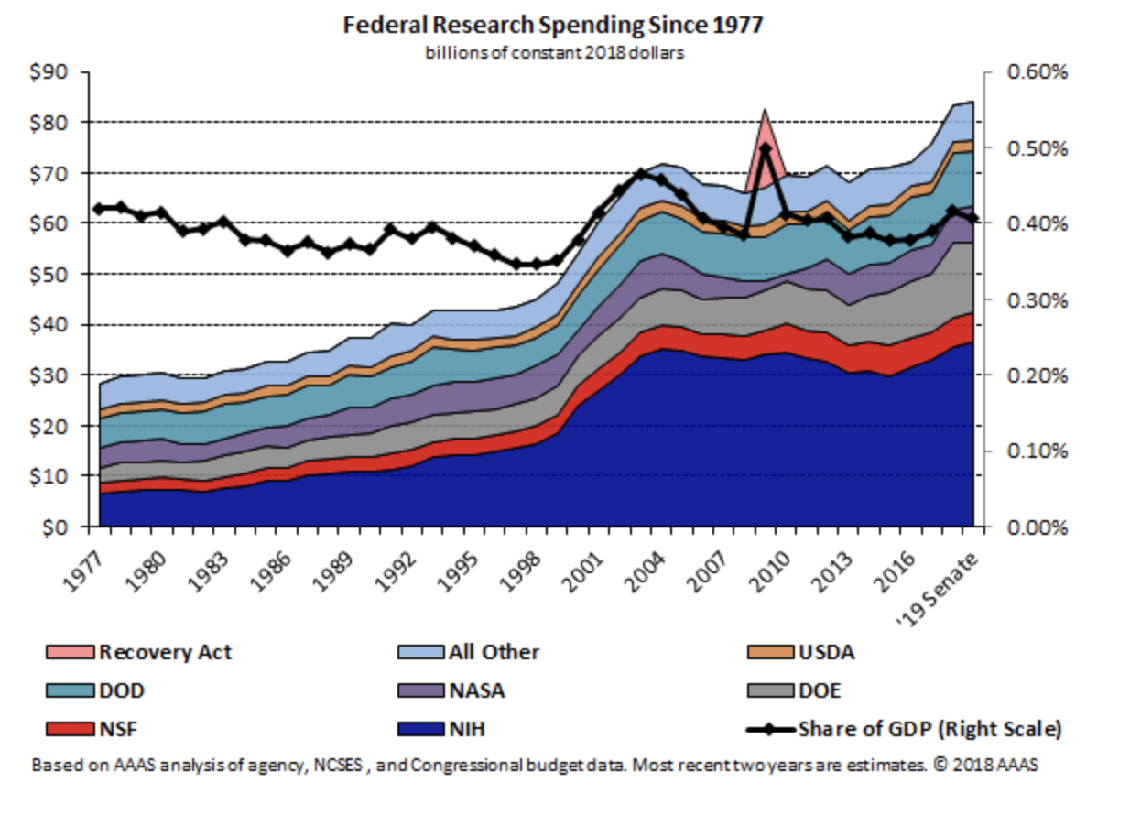
With completion of the Defense and Labor, HHS, and Education spending bills by the Senate Appropriations Committee late last month – marking the committee’s fastest work in decades – research funding in the 2019 fiscal year could top $85 billion, according to current AAAS estimates. This would mark the highest point ever for such spending.

Slide 28
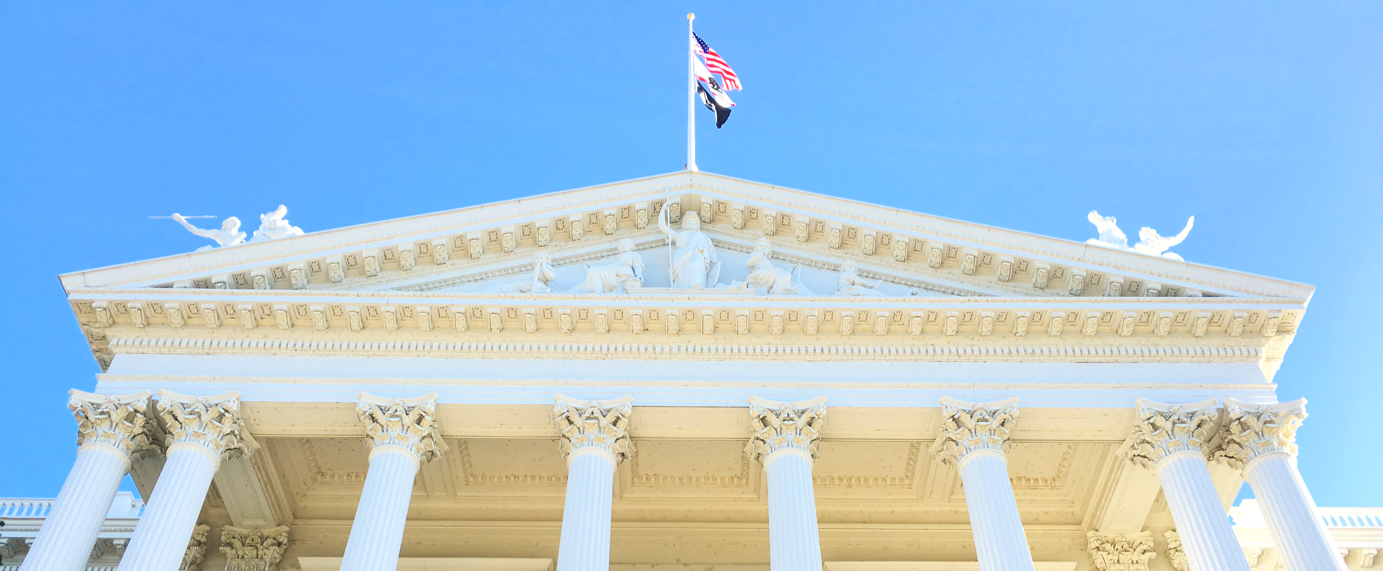
What Does All This Mean for You?

Slide 29
What Do Policymakers Care About?
They genuinely care about making a difference for California’s people, economy, and environment.
They specifically care about the district they represent, an issue area they prioritize, or the jurisdiction of their office.
They want to be seen as caring, informed leaders with foresight and innovation.

Slide 30
What Rules Must They Play By?
Money: Amazing policy ideas often have a price tag. What would it cost, how do we pay for it?
Implications: What are the possible effects of a policy idea on existing or future laws, regulations, and efficiency? Who will implement this policy, and how?
Optics: How does this policy make me look to the media, to my voters, and to my party colleagues?

Slide 31
How Do They Consume Information?
Legislative and Executive Branch leaders all rely on their staff and designates to distill a firehose of information down to key policy takeaways.
Staff are equally taxed with “sorting signal from noise” — you must clearly point out the big-picture connection of your research to their policy priorities, before diving into details.

Slide 32
How Do I Speak as an Advisor?
The best advisors explain possible implications of a scientific finding, then offer recommendations or assess scenarios based on data or professional experience.
Open with the big picture, and then dive into the details.
You are not there to advocate. You are there to present options.

Slide 33
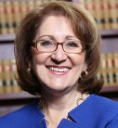
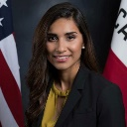
UCR’s State Legislative Delegation
9 State Assemblymembers:
4 State Senators:
Assemblymember
Eloise Reyes
(D-San Bernardino)
Assemblymember
Melissa Melendez
(R-Lake Elsinore)
Senator
Connie Leyva
(D-Chino)
Assemblymember
Eduardo Garcia
(D-Coachella)
Assemblymember
Jay Obernolte
(R-Big Bear)
Senator
Mike Morrell
(R-Rancho Cucamonga)
Assemblymember
Sabrina Cervantes
(D-Corona)
Assemblymember
Freddie Rodriguez
(R-Pomona)
Senator
Richard Roth*
(D-Riverside)
Assemblymember
Chad Mayes
(R-Yucca Valley)
Assemblymember
Marc Steinorth
(R-Rancho Cucamonga)
Senator
Jeff Stone
(R-Temecula)
Assemblymember
Jose Medina*
(D-Riverside)
*Represents UCR as part of jurisdiction

Slide 34
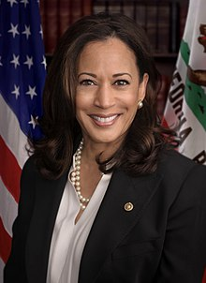
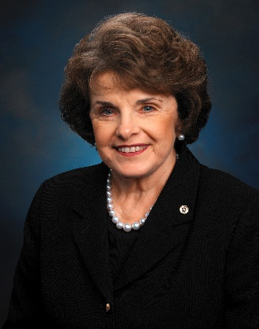
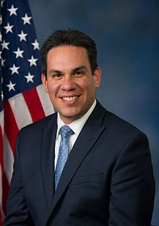
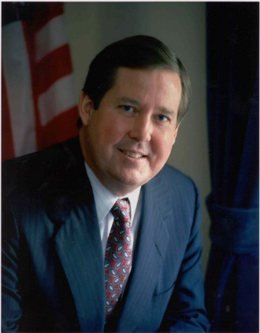
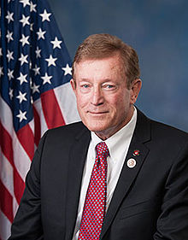
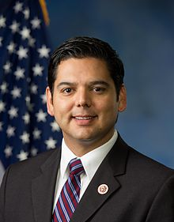
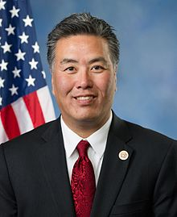
UCR Congressional Delegation
Sen. Kamala Harris (D)
Cmtes: Homeland Security; Budget; Judiciary
Sen. Dianne Feinstein (D)
Cmtes: Approps, Judiciary
Pete Aguilar (D)
Cmtes: Approps, Energy & Water, Transp. & Housing
Ken Calvert (R)
Cmtes: Approps; Chair Interior Approps
Paul Cook (R)
Cmtes: Armed Services, Foreign Affairs; Nat Resources
Raul Ruiz (D)
Cmtes: Energy & Commerce
Mark Takano (D)
Cmtes: RM on Vets; Science; Ed & Workforce

Slide 35
Stay Connected
Share your ideas
@UCRS2P
www.sciencetopolicy.ucr.edu
sciencetopolicy@engr.ucr.edu

Slide 36
Respect Science
The limits of science must be identified and respected. Otherwise science will fall into disrespect having been abused and exploited by those with ideological agendas.
Peter Medawar
1)"science is never settled" -- if a theory cannot be falsified by some new observation it is not a scientific theory but an ideology
2) "science is morally blind" -- by science you can design a new vaccine or a new gas chamber. The moral responsibility for the use of science lies outside science.

